Slide 1
Standing Waves on a Vibrating String
By Jacob Stanley and Edmond Klarić

Slide 2
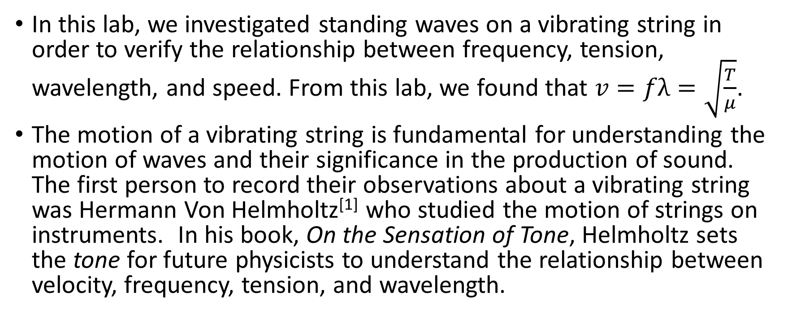
Abstract and Introduction
In this lab, we investigated standing waves on a vibrating string in order to verify the relationship between frequency, tension, wavelength, and speed. From this lab, we found that $v=fλ=\sqrt{\frac{T}{μ}}$.
The motion of a vibrating string is fundamental for understanding the motion of waves and their significance in the production of sound. The first person to record their observations about a vibrating string was Hermann Von Helmholtz^{[1]} who studied the motion of strings on instruments. In his book, On the Sensation of Tone, Helmholtz sets the tone for future physicists to understand the relationship between velocity, frequency, tension, and wavelength.

Slide 3
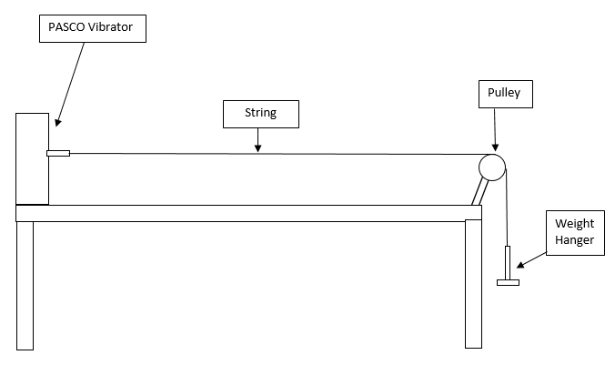
Diagram of Our Setup

Slide 4
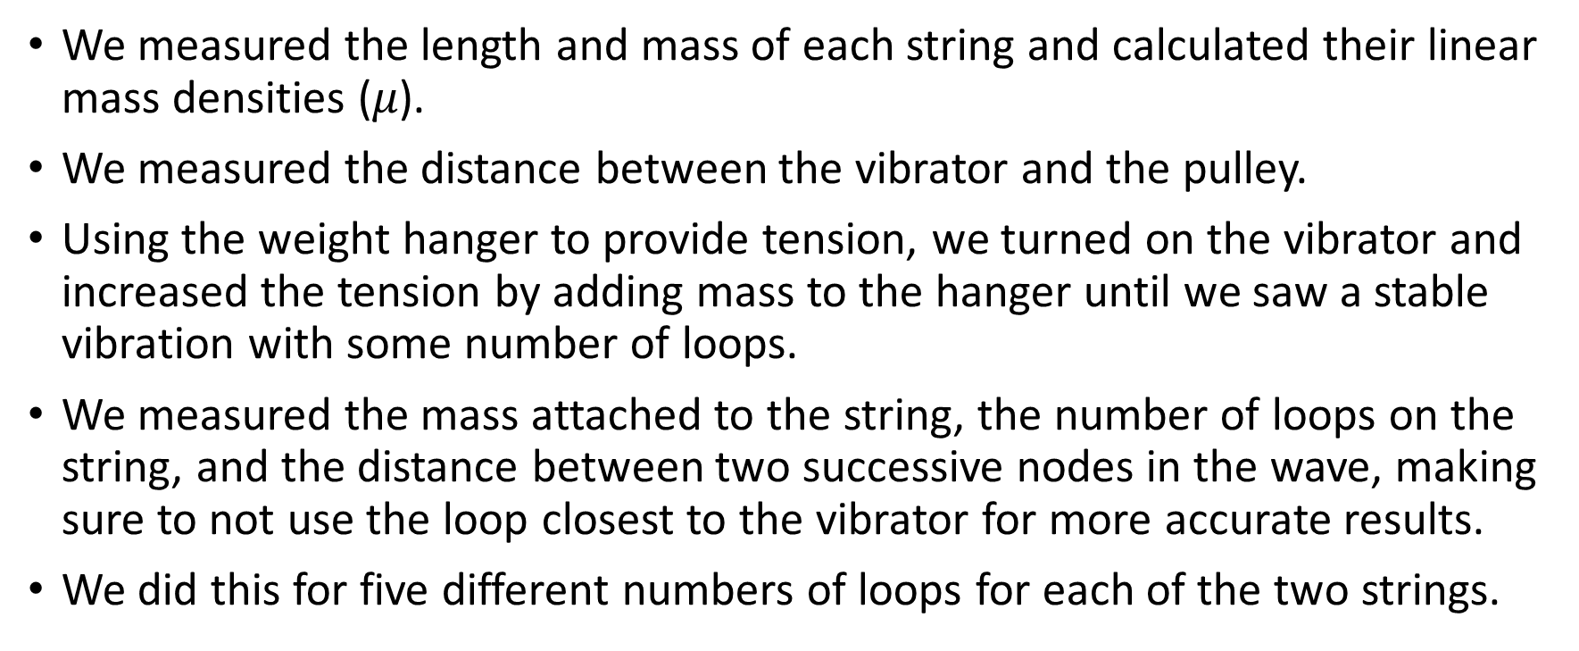
Procedure
We measured the length and mass of each string and calculated their linear mass densities ($μ$).
We measured the distance between the vibrator and the pulley.
Using the weight hanger to provide tension, we turned on the vibrator and increased the tension by adding mass to the hanger until we saw a stable vibration with some number of loops.
We measured the mass attached to the string, the number of loops on the string, and the distance between two successive nodes in the wave, making sure to not use the loop closest to the vibrator for more accurate results.
We did this for five different numbers of loops for each of the two strings.

Slide 5
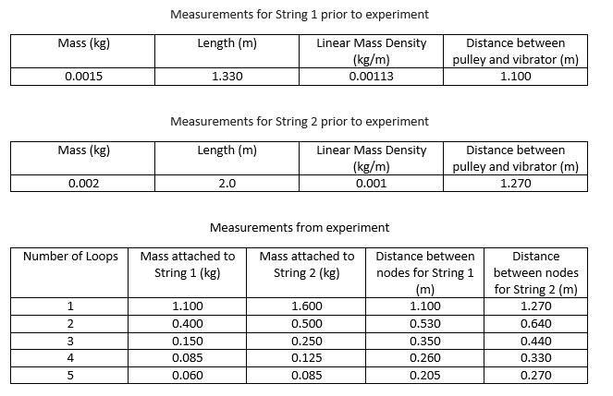
Measurements and Calculations

Slide 6
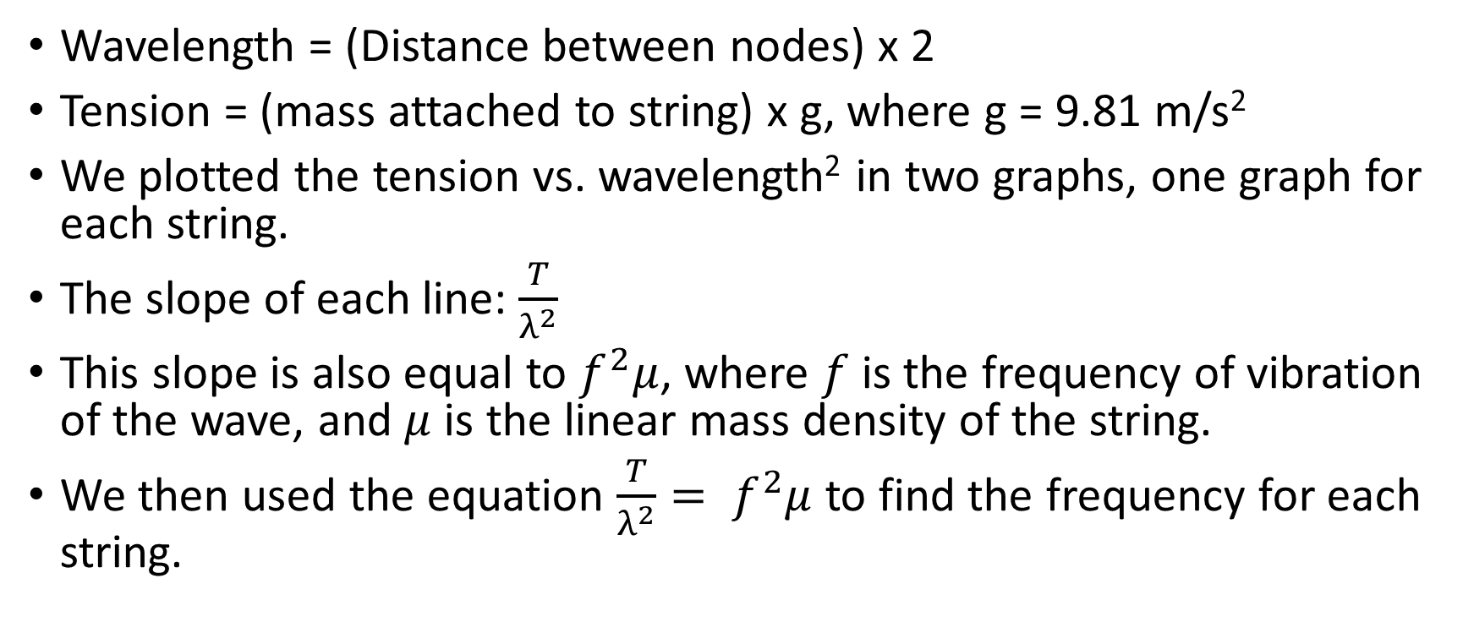
Results/Analysis/Physics
Wavelength = (Distance between nodes) x 2
Tension = (mass attached to string) x g, where g = 9.81 m/s²
We plotted the tension vs. wavelength² in two graphs, one graph for each string.
The slope of each line: $\frac{T}{λ^{2}}$
This slope is also equal to $f^{2}μ$, where $f$ is the frequency of vibration of the wave, and $μ$ is the linear mass density of the string.
We then used the equation $\frac{T}{λ^{2}}= f^{2}μ$ to find the frequency for each string.

Slide 7
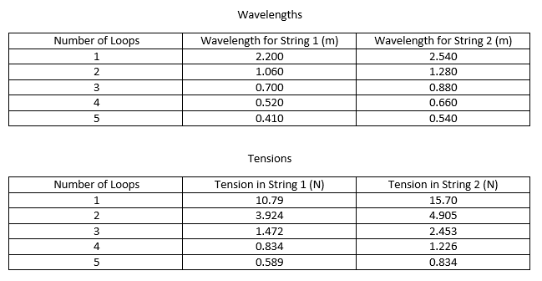
Measurements and Calculations Continued

Slide 8
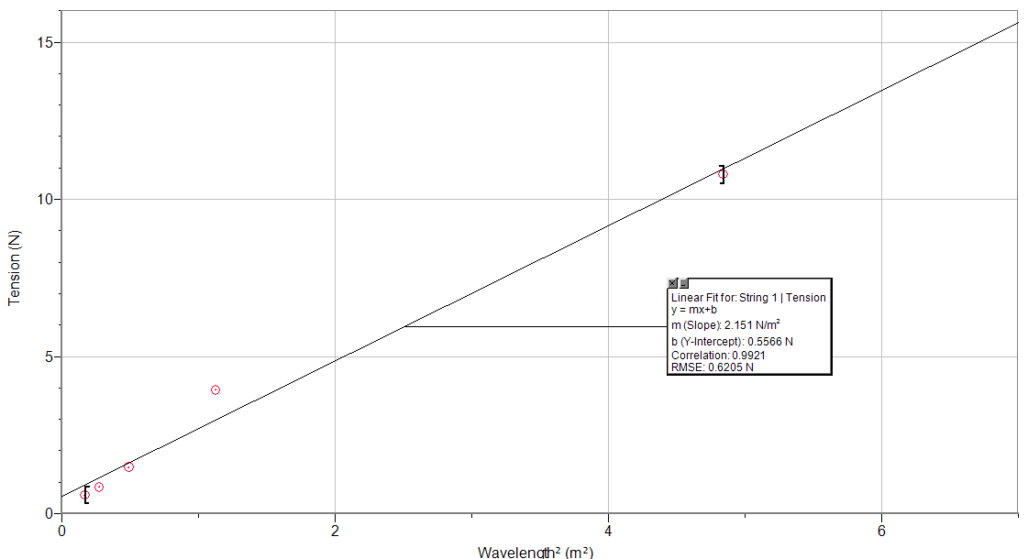
Graph of Tension (N) vs. Wavelength² (m²) (String 1)

Slide 9
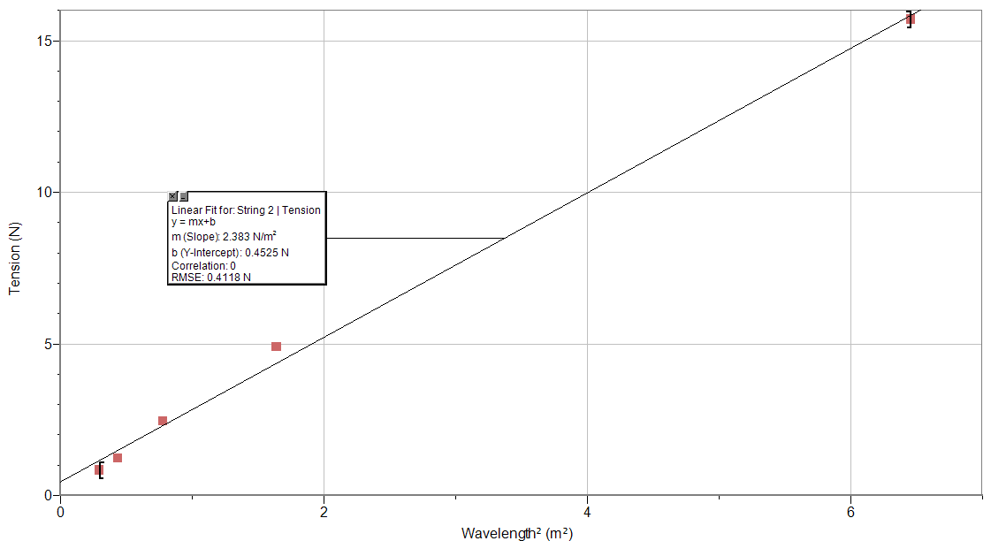
Graph of Tension (N) vs. Wavelength² (m²) (String 2)

Slide 10
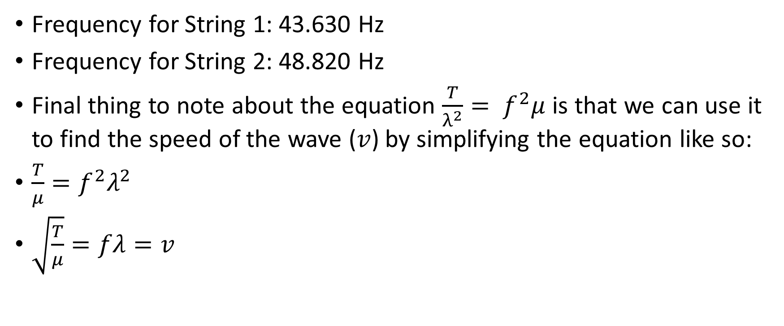
Results/Analysis/Physics Continued
Frequency for String 1: 43.630 Hz
Frequency for String 2: 48.820 Hz
Final thing to note about the equation $\frac{T}{λ^{2}}= f^{2}μ$ is that we can use it to find the speed of the wave ($v$) by simplifying the equation like so:
$\frac{T}{μ}=f^{2}λ^{2}$
$\sqrt{\frac{T}{μ}}=fλ=v$

Slide 11
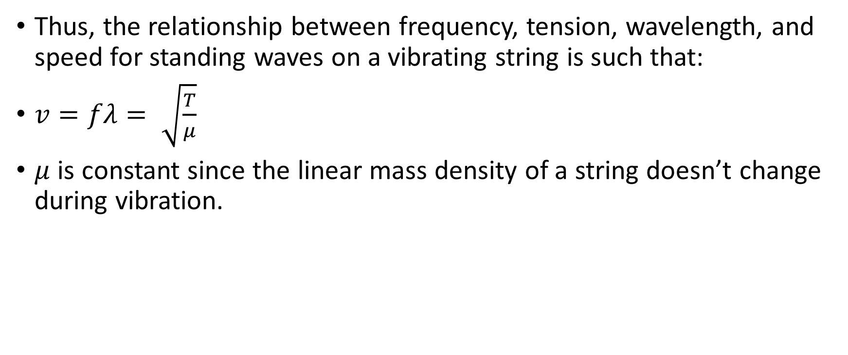
Conclusion
Thus, the relationship between frequency, tension, wavelength, and speed for standing waves on a vibrating string is such that:
$v=fλ= \sqrt{\frac{T}{μ}}$
$μ$ is constant since the linear mass density of a string doesn’t change during vibration.

